Slide 1
School Name: School Of CS & IT
Course / Semester(s): M.Sc. CSIT / 1st
Team Name: Team Obsaline
Team Members : 6
Sl. No | Name | Contribution to prototype
1. | SHAH JAINAM ABHAYBHAI | Creation of IOT Prototype
2. | KHADELA ASHISH MAHESHBHAI | Creation of IOT Prototype
3. | GANDHI SHIV KETANKUMAR | Creation of backend database
4. | RAO KASHISH DHANESHWAR | Creation of backend database
5. | MEHTA HELIKUMARI MITENKUMAR | Creation of Android Application
6. | MANDALIYA YASHKUMAR JASRAJ | Creation of Android Application

Slide 2
Target Users:
-> Rural Area Hospitals
-> Semi-Urban Area Hospitals
Problem Statement:
-> As per the current report of Nov 2023 more than 6cr people are admitted due to the different health issue like injured, dehydrated and undergoing surgery, they are often injected with fluids through an IV bag. However, leaving the IV bag suspended and empty for a long period of time can cause complications.
Such as:
Reverse Osmosis(Reverse Flow of Blood)
Air Embolism which can further increase the risk of stroke or a heart attack.

Slide 3
Solution:
-> To avoid the risks associated with an empty IV bag, which can cause complications like reverse osmosis or air embolism, it is crucial for the IV bag to be monitored by an attending nurse. However, human negligence can sometimes occur. To mitigate this risk, we have developed an automated device that monitors the IV bag's fluid level, ensuring continuous and accurate tracking.
Novelty/ Innovation:
-> Added notification and alarm system to nurse mobile.

Slide 4
Social – Economic Impact:
-> Socially it reduce the workload of the hospital and manage the risk. It improves patient safety, leading to fewer readmissions and shorter hospital stays. The sensor also boosts efficiency by automating monitoring, reducing labor costs. It helps optimize resource allocation, minimizing waste and maximizing hospital resources. Overall, it contributes to cost savings and enhances the healthcare system's financial sustainability.
Market Potential:
->The IV bag sensor has strong market potential, addressing risks like Reverse Osmosis and Air Embolism in over 60 million annual IV procedures in India alone. It enhances patient safety, reduces human error, and aligns with trends in healthcare automation. Globally, it offers cost savings and vast opportunities for adoption in hospitals and clinics.

Slide 5
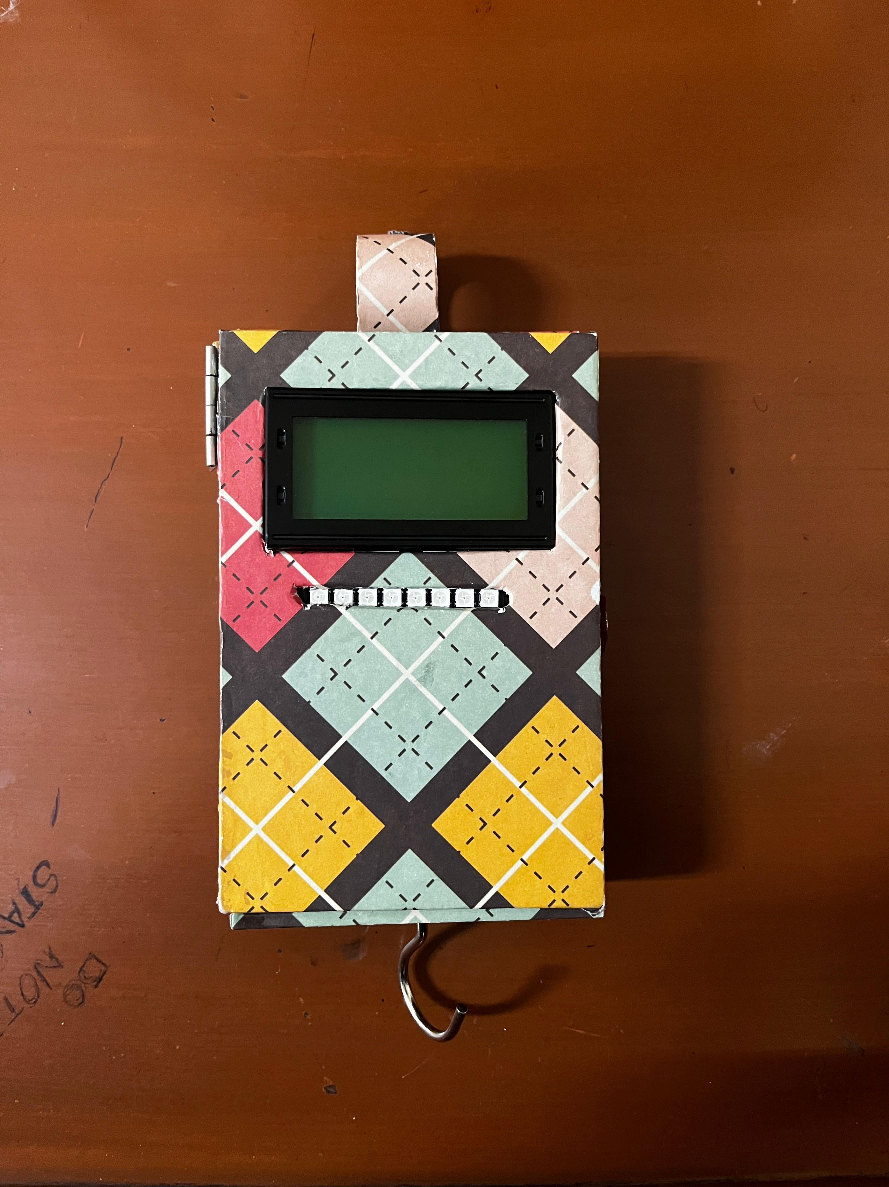
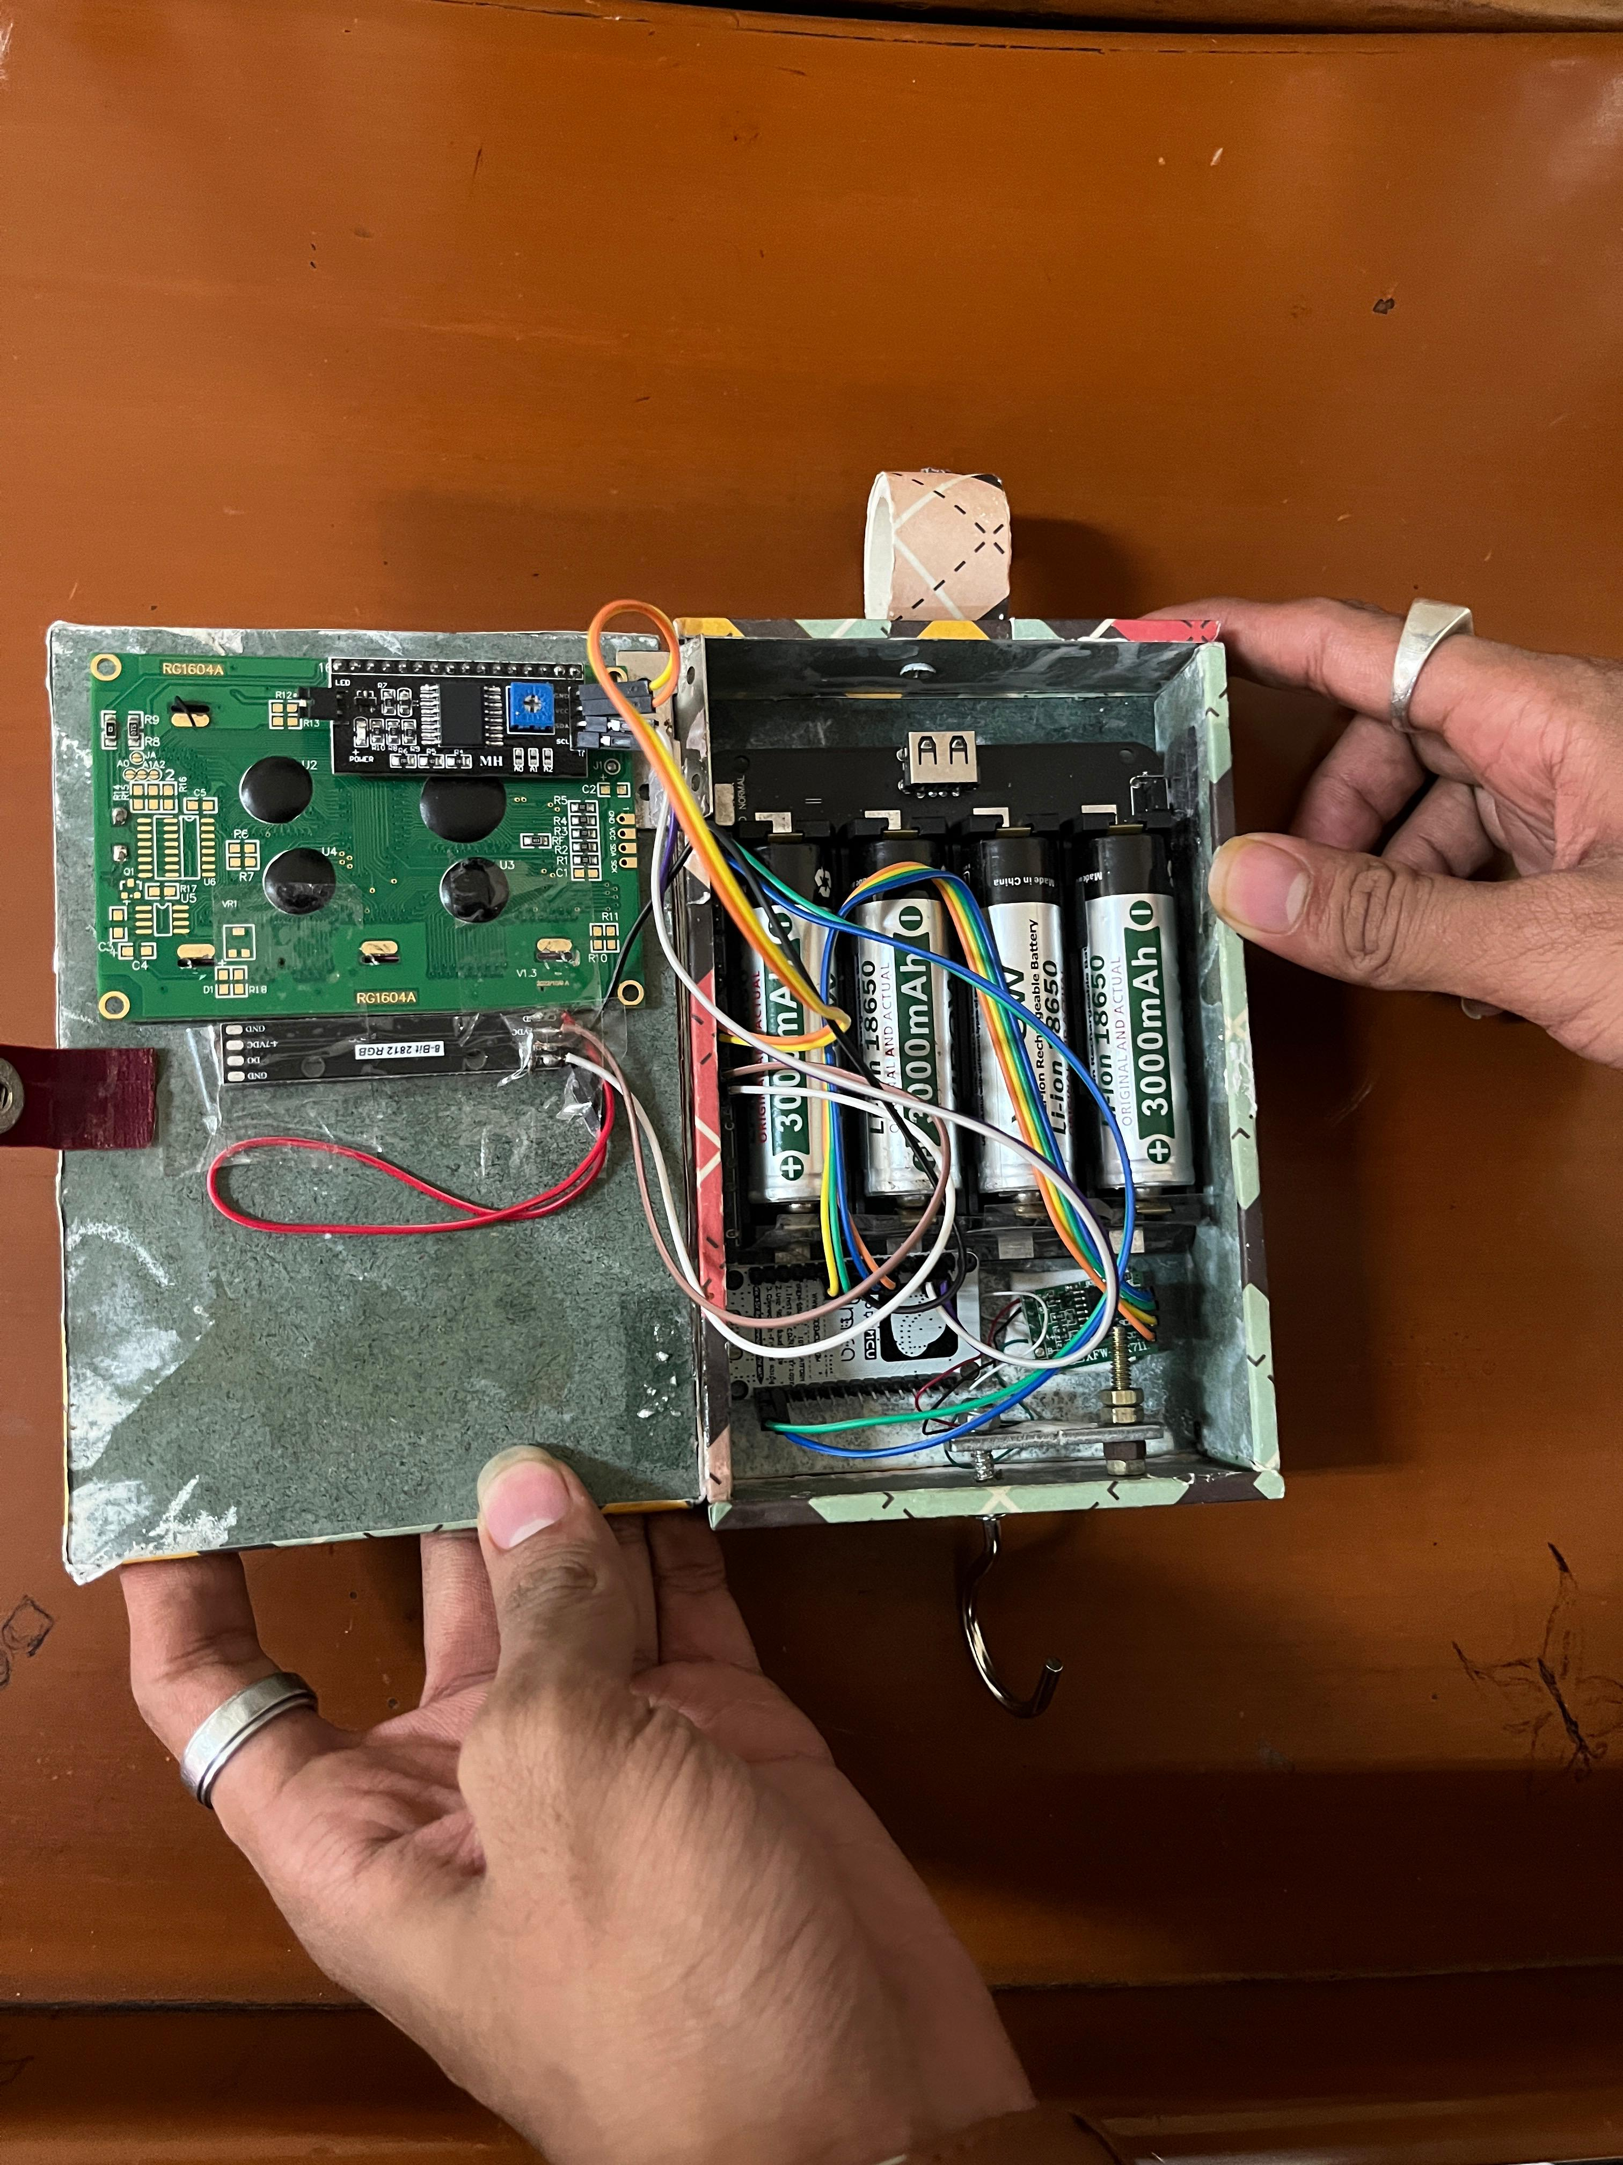
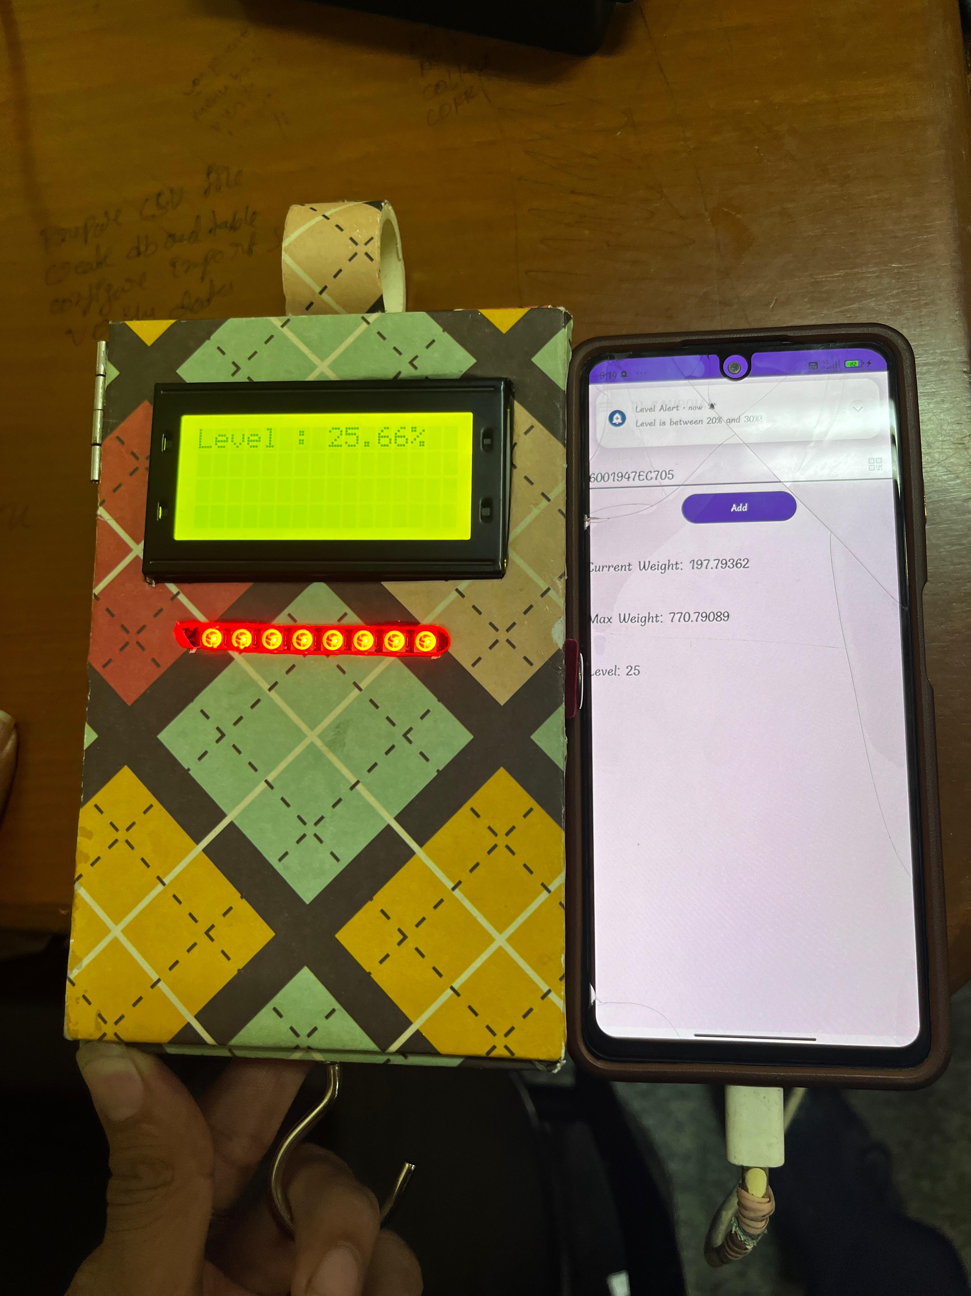
Prototype picture:

Slide 6
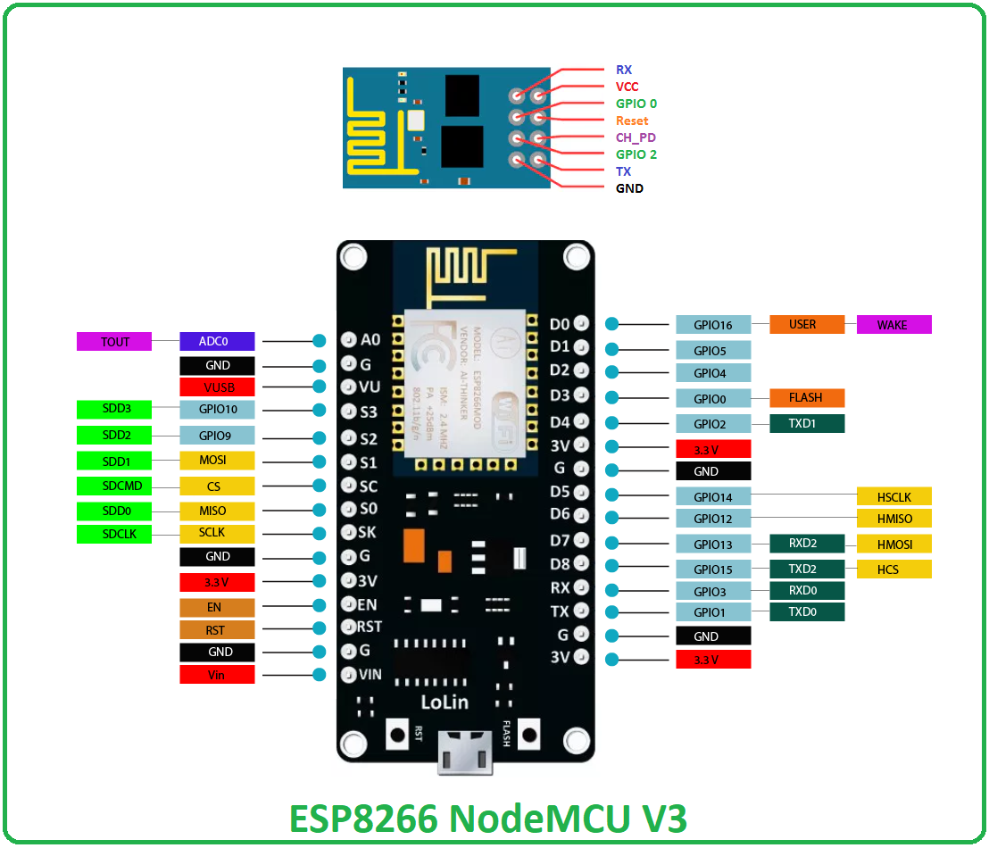
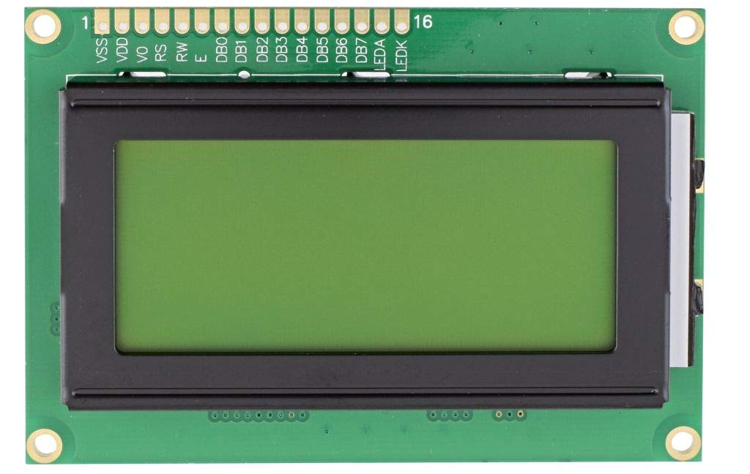
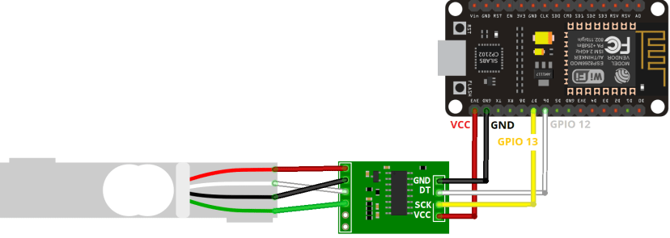
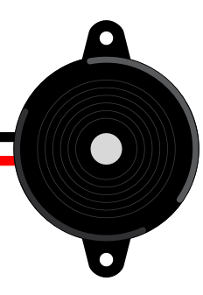

Component:

Slide 7
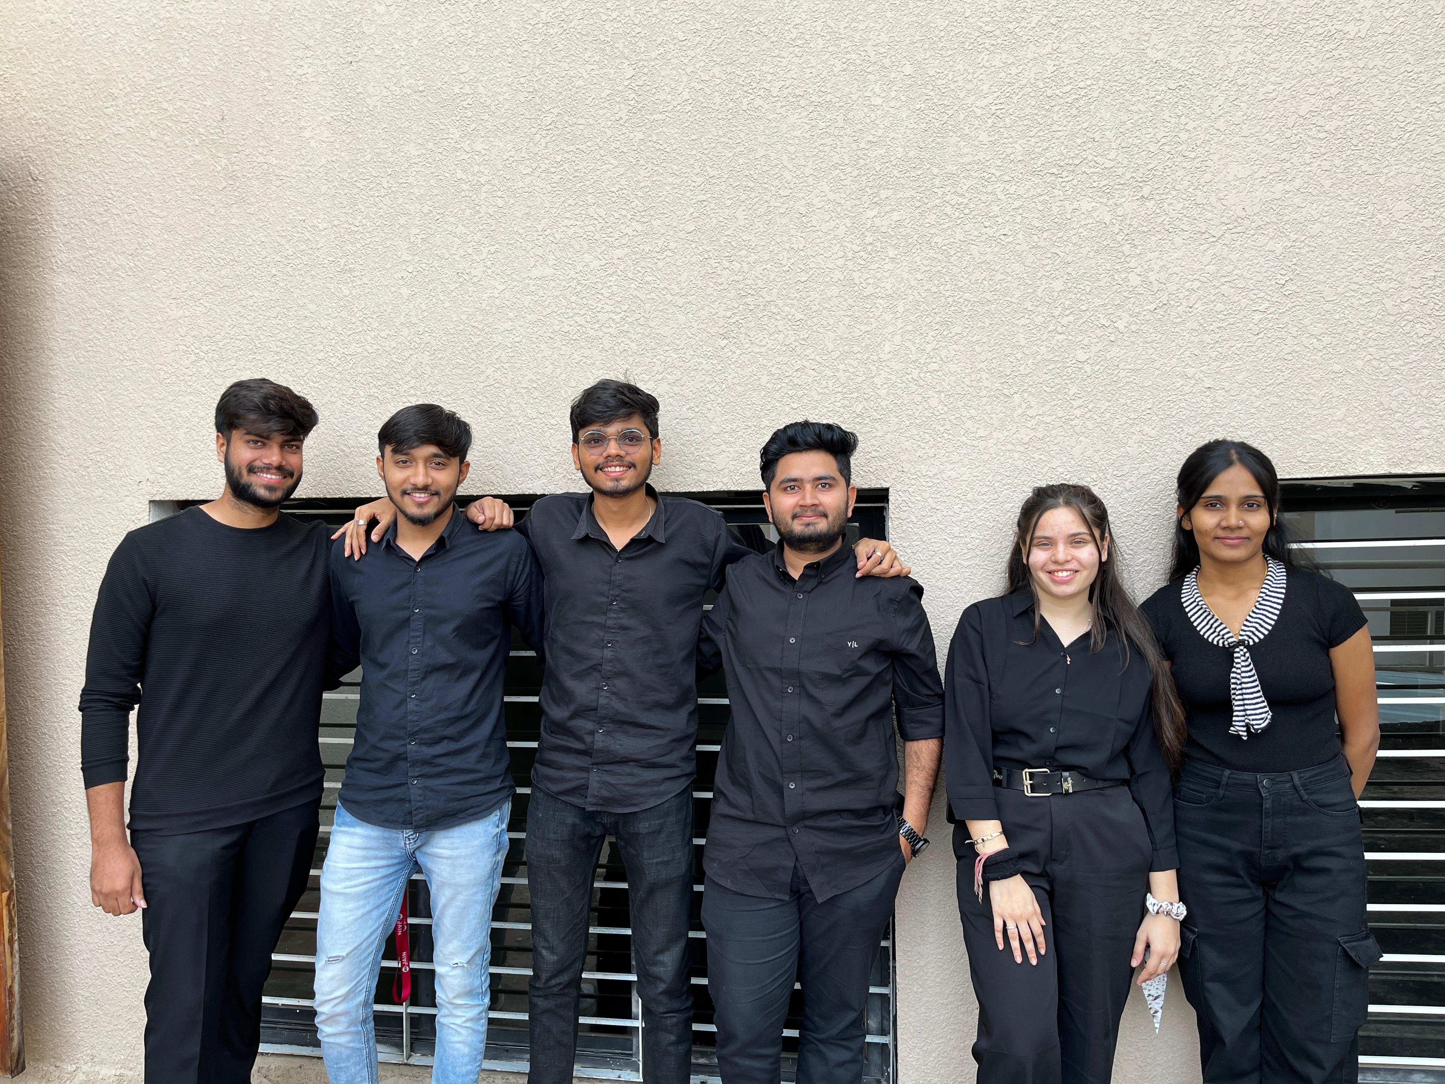
Team Photo:

